Slide 1
Opioid Settlement Funds
Harrison County Opioid Economic Funding Board

Slide 2
Goal: distribute the funds to make the most impact while adhering to the
“core strategies” spelled out in the requirements of the MOU.

Slide 3
Approved Purposes
Evidence based strategies, programming and /or services used to expand the availability of treatment for individuals affected by substance use disorders and/or addiction, to develop, promote and provide avoidance and awareness education, to engage in enforcement to curtail the sale, distribution, promotion or use of opioids and other drugs, to decrease the oversupply of licit and illicit opioids and to support recovery from addiction to be performed by qualified providers as is further set forth in Exhibit A (schedule A & B) of the West Virginia First Memorandum of Understanding.

Slide 4
The Buckets Disbursement
Prevention*
Response*
Recovery*
*Approved Purposes
Where does our project fit?
This Photo by Unknown Author is licensed under CC BY-NC

Slide 5
Organizations or programs seeking funding will be required go through an application process that shows proof of an evidence-based solution based on the core strategies and criteria expressed in the MOU.
www.harrisoncountywv.com

Slide 6
Core Strategies-Which bucket do they fall in?
Naloxone or other FDA-Approved Drug to Reverse Opioid Overdoses
Medication-Assisted Treatment (MAT) Distribution and other Opioid-Related Treatment
Pregnant & Postpartum Women
Expanding Treatment for Neonatal Abstinence Syndrome
Expansion of Warm Hand-Off Programs and Recovery Services
Treatment for Incarcerated Population
Prevention Programs
Evidence -Based Data Collection and Research Analyzing the Effectiveness of the Abatement Strategies Within the State
Law Enforcement
Evidence-based research
First Responders-Education on dealing with drug-related responses, Wellness, and support services for responders with secondary trauma associated with opioid-related emergency events.

Slide 7
Prevention Bucket
Education-Prevention Programs
School-based, First Responder, Law Enforcement,
Evidence-Based Data Collection and Research
Analyzing the Effectiveness of Abatement Strategies Within WV.
Others ?
Media campaigns, antidrug coalitions, community-based education or intervention services for at-risk families, youth, and adolescents
community support groups

Slide 8
Response Bucket
Naloxone and Naloxone “Plus”
Support agencies that are already involved in distribution to reverse opioid overdoses. Linkages to care for other appropriate services
First Responders
Wellness and support services for responders with secondary trauma associated with opioid-related emergency events. Education for responses involving opioid use disorder.
Law Enforcement
Support efforts to curtail the sale, distribution, promotion or use of opioids and other drugs, reduce the oversupply of licit and illicit opioids, regional jail fees.
Rapid Response Teams
Case Management from start to finish. Social Workers, Substance Abuse Counselors, Peer Support, Warm Hand-off Services, On Call Teams

Slide 9
Recovery Bucket
Addiction Recovery
Medication-Assisted Treatment Distribution and other opioid Related Treatment
Pregnant and Postpartum
Agencies to provide screenings, intervention, and referral services to treatment
Wrap Around Services
support to individuals with housing, transportation, job placement/training, childcare
Connections to Care
Health Screenings
Mental Health
Recovery Coaches
Case Management-start to finish

Slide 10
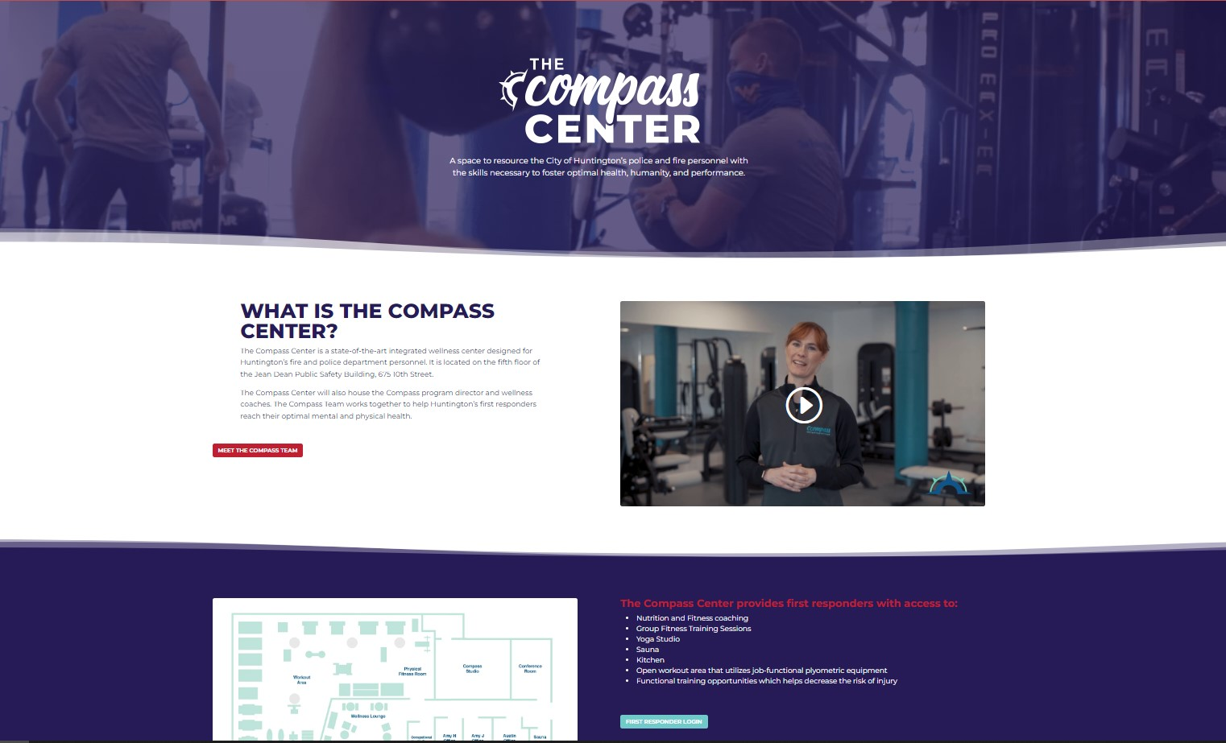
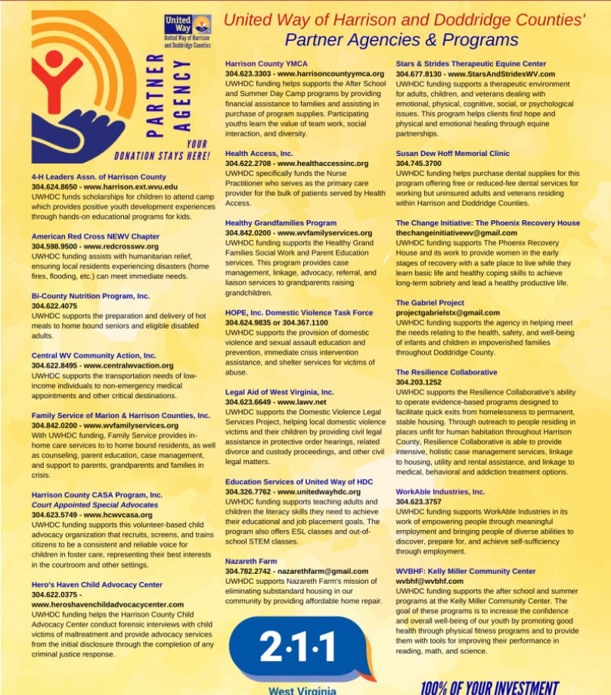
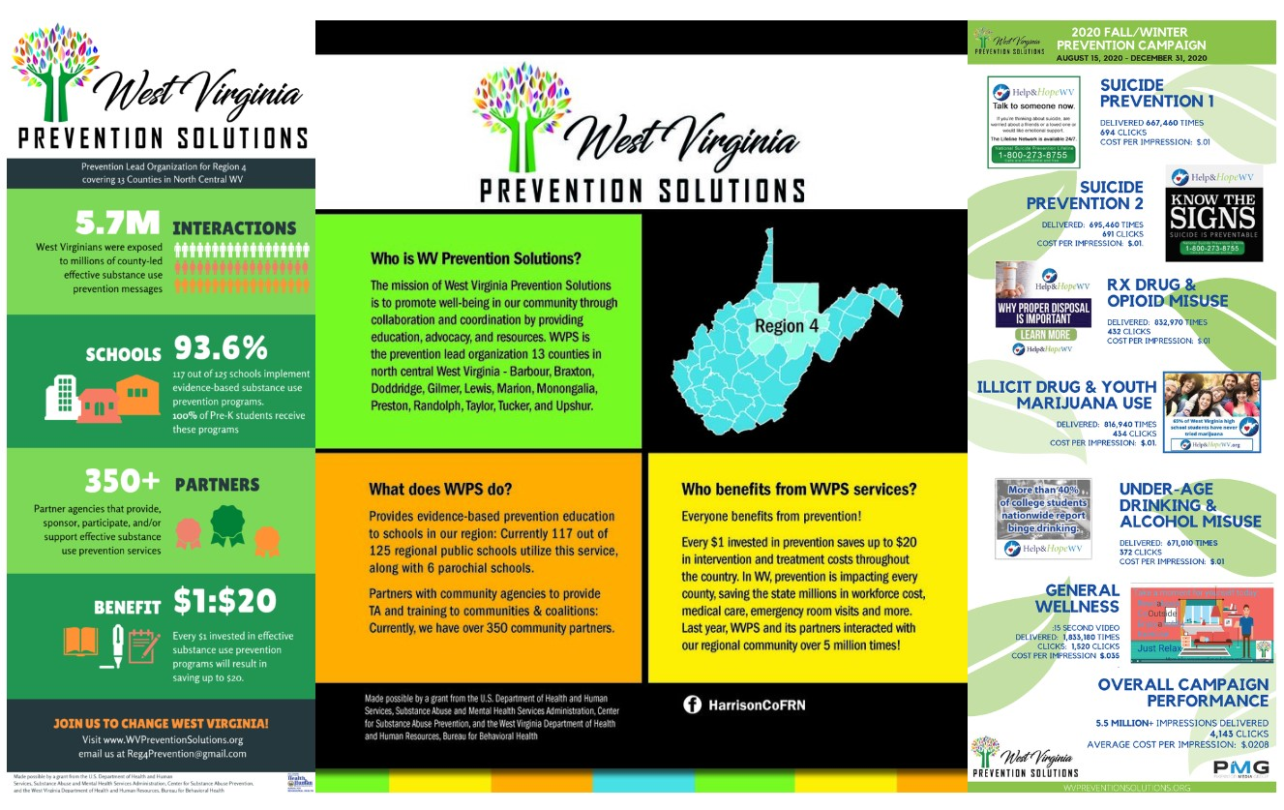
Resource, Group, Program Examples

Slide 11
Summary
*Distribution of funds must follow the guidelines presented in the MOU. The three buckets of distribution most agencies and programs fall into:
Prevention, Response, Recovery
*Programs, Research, and Education must be evidence-based.
*It is in the best interests of our community that case management of the individual should be from start to finish for the safety of our community.
Contact: opioidfund@harrisoncountywv.gov

Slide 12
Applications Due
July 15th, 2024
Mail to:
Opioid Funding Committee
301 W. Main St.
3rd Floor Court House
Clarksburg, WV 26301
opioidfund@harrisoncountywv.gov

